Slide 1
Object Oriented Programming
Abstract Classes and Interfaces
Lecture 4
Notes:
Part of this lecture will be reserved for working through solutions to selected exercises from last week. Notes relating to this do not appear in the slides.

Slide 2
Objectives
In this lecture, we will
Discuss Abstract classes
Build class hierarchies based on abstract classes

Slide 3
Introduction
The concept of an abstract class will be introduced through a simple example.
Consider designing a simple drawing package.
Initially the package must be able to draw simple objects such as
  Rectangles
  Filled rectangles
An obvious place to start is identifying candidates for classes and corresponding attributes and methods
  a rectangle class
  a size, a position
  a constructor, a draw method

Slide 4
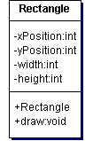
Rectangle Class
A simple rectangle class:

Slide 5
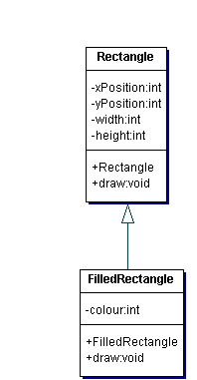
A FilledRectangle class
A filled rectangle is a specialisation of the rectangle class
Inheritance is used to derive a FilledRectangle class from the Rectangle class
The derived class
  adds a colour attribute
  overrides the draw method

Slide 6

Extending the Drawing Package
Suppose it is necessary to extend the drawing package to be able to draw circles
A circle class can be written
  A circle has a radius
  A circle has a position
  A circle needs a draw method

Slide 7
Circle and the Rectangle class
A Picture holds a collection of rectangles and filled rectangles
A circle is not a rectangle therefore it is not easy to work with a combination of circles, rectangles and filled rectangles
However, circles and rectangles have some common features
  Each has an xPostion and a yPosition
  Each knows how to draw itself
These common features could be abstracted out to form a new class
  A base class for both rectangles and circles

Slide 8

A Shape class
A shape class is one possibility
  A rectangle IS-A shape
  A circle IS-A shape
What is a Shape?
How would you draw a Shape?
  How is draw implemented?
A Shape never exists in its own right
A Shape is used as a base class for a Rectangle or as a base class for a Circle
A Shape is an abstract class
  A class that is never instantiated

Slide 9
Abstract Classes in Java
Java allows abstract classes to be defined using the keyword abstract
  public abstract class Shape ….
An abstract class
  Cannot be directly instantiated
An abstract method is defined with the keyword abstract
  public abstract void draw() ;
An abstract method must be overridden in derived classes
  Implemented in the derived class
  Unless the derived class is itself abstract

Slide 10
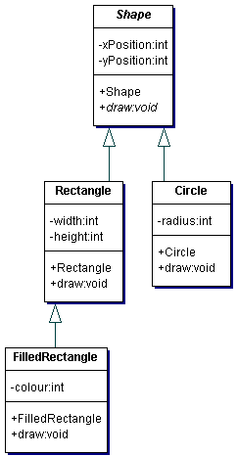
Shape as an Abstract base class
In together abstract is indicated by italic text
  Shape
  draw

Slide 11
References to Abstract classes
Although abstract classes cannot be instantiated it is possible to use variables that hold references to abstract classes
For example:
  Shape theShape;
What types of objects can theShape refer to?
  Any instances of classes derived from Shape
For example:
  Circle myCircle = new Circle ( 40, 50, 50 );
  theShape = myCircle;

Slide 12
References to Abstract classes
What affect does the following code have?
  theShape.draw( );
The variable theShape is specified as a reference to a Shape
The value store in the variable actually refers to a Circle
Hence, the run time environment binds to the draw method of Circle
  POLYMORPHISM comes into play

Slide 13
Abstract Classes
Why do we work with abstract classes?
An abstract class allows us to identify and group together the common attributes and methods for a set of classes
  The same code can then be re-used through inheritance as the base of any of the derived classes
Designing a system around abstract classes makes it easier to extend the system
  It is easy to add new classes derived from the abstract class that will work in the system without modifying the core logic of the system

Slide 14
Interfaces
A class specifies
  Member variables
  Member methods
The methods contain code that defines how to carry out the operations defined by the methods
  Implementation
Sometimes it is useful to separate what an object can do from how it does it
An interface specifies what an object should be able to do without specifying how or what the object is
Notes:
Diamond problem – Why java does not allow multiple inheritance?

Slide 15
Interfaces
This allows us to consider each of the following in class design
Inheritance
  The IS-A relationship
Containment
  The HAS-A relationship (Will discuss later)
Interface
  Used to specify that an object is able to do something

Slide 16
Interfaces
In Java an interface is specified using the keyword interface in place of class
  All the methods in an interface must be abstract
  Only final static member variables are allowed
For example:
    interface Drawable
    {
    public void draw ();
    }

Slide 17
Implementing an Interfaces
A class can implement an interface
In order to do this the class must provide an implementation of the abstract methods specified in the interface
For example, a Circle knows how to draw so it could implement the Drawable interface:
    public class Circle extends Shape implements Drawable
    { …
An instance of Circle IS-A Shape
An instance of Circle is able to do the operations specified in the Drawable interface

Slide 18
References to Interfaces
It is possible to have a variable that is a reference to a Drawable
  Drawable theDrawable;
What type of object can theDrawable refer to?
Any object that is an instance of a class that implements the Drawable interface
  Circle c = new Circle (40, 50, 50);
  theDrawable = c;

Slide 19
Summary
In this lecture we have:
Discussed Abstract classes
Built class hierarchies based on abstract classes
Discussed about interfaces

